Slide 1




NEXT GEN EMPLOYABILITY PROGRAM
Creating a future-ready workforce
Team Members
College Name
Student Name :M.Vaishnavi
Student ID :au951221104056
JP College Of Engineering

Slide 2

CAPSTONE PROJECT SHOWCASE
Project Title
Voting Application using Django Framework
Abstract | Problem Statements| Project Overview | Proposed Solution | Technology Used | Modelling & Results | Conclusion

Slide 3
Abstract:
"DjangoVote" is a web-based application built using the Django framework, designed to facilitate voting processes for various purposes such as elections, surveys, or contests. The application provides a user-friendly interface for both administrators and voters, ensuring ease of use and efficiency in managing and participating in voting activities.

Slide 4
Problem Statement:
The goal is to develop a user-friendly, secure, and scalable online voting system using the Django web framework. This system will allow registered users to vote in different polls or elections set up by the administrators. The results of these polls should be immediately accessible and verifiable to ensure transparency and trust in the voting process.

Slide 5
Project Overview:
VoteX is a web-based application developed using the Django framework to facilitate various voting processes such as elections, surveys, and contests. The platform aims to provide a user-friendly interface for both administrators and voters, ensuring efficiency, security, and scalability in managing and participating in voting activities.

Slide 6
Proposed Solution:
1. Using Django’s Authentication System
2. Develop functionalities to manage voting process
3.Allow administrator to create and manage the ballot for each voting
4. Use https for encrypt data transmission between the client and the server
5. Implement the real time result tracking for users to view updated result

Slide 7


Technology Used
Front-end
Back-end
Source :

Slide 8
Modelling & Results:
Modeling a voting application using the Django framework involves designing the database structure to represent various entities such as users, voting events, candidates, and votes.
1. User Model
2. VotingEvent Model
3. Candidate Model
4. Vote Model

Slide 9
Advantages:
Efficiency: Utilizing the Django framework allows for rapid development of the voting application, thanks to its built-in features and conventions. This accelerates the development process and reduces time-to-market.
Security: Django incorporates security features by default, such as protection against common web vulnerabilities like SQL injection and cross-site scripting (XSS). Additionally, Django's authentication system helps in securely managing user accounts and permissions.
Community Support: Django has a large and active community of developers who contribute to its ecosystem. This ensures the availability of extensive documentation, third-party packages, and community support, making it easier to troubleshoot issues and implement new features.

Slide 10
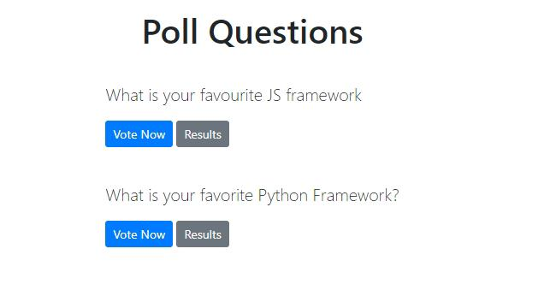

Homepage

Slide 11
About-us-page:
1.Credibility:
The "About Us" page establishes credibility by providing information about the organization's history, mission, and team members
2.Mission and Values:
It communicates the organization's mission, values, and objectives in promoting democratic participation and decision-making.
3. Community Engagement:
The page showcases the organization's commitment to community engagement and empowerment through the voting process, inspiring active participation.
4. Contact Information:
Users can easily reach out with questions, feedback, or inquiries about the voting application through the contact information provided on the page.

Slide 12
Features:
.
User Authentication
Administration Dashboard
Flexible Voting Options
Real-time Results
Accessibility and Responsiveness
Security and Integrity
Scalability and Customization

Slide 13
Service-Page:
.
1.Header Section
2.Introduction section
3.User Services
4.Administrator Services
5.Organizational Services
6.Technical Services
7.Consulting Services
8.Call to Action Services

Slide 14
Departments-page:
.
Header Section
Introduction Section
Department Listings
Department Details
Key Personnel
Collaboration Opportunities
Footer Section

Slide 15
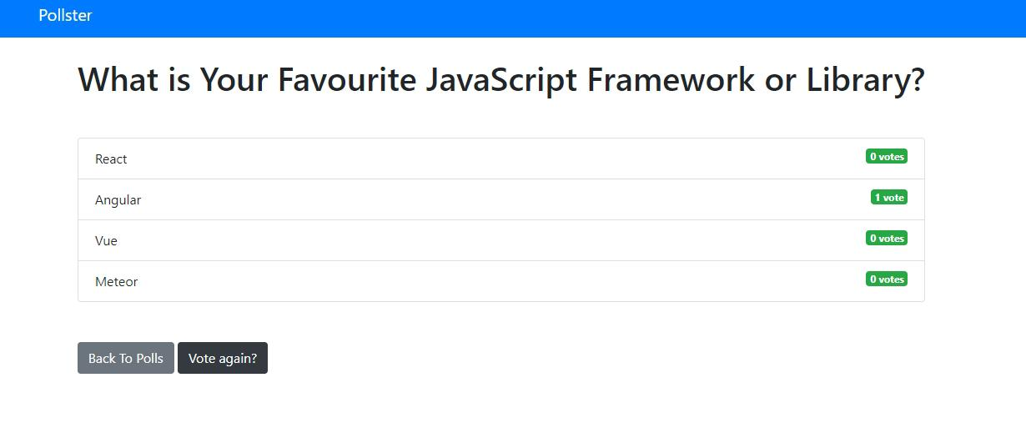
Blog-Page

Slide 16
Future Enhancements:
In the pursuit of advancing the voting application, several avenues for enhancement present themselves to enrich its functionality and user engagement.
One promising direction is the integration of advanced analytics tools, enabling administrators to glean deeper insights into voting behaviors, demographic trends, and predictive modeling for future electoral outcomes.
Furthermore, the incorporation of social media integration could amplify user engagement by allowing participants to share their voting activities and poll results seamlessly across popular platforms, fostering a wider reach and encouraging community involvement.
Future ScopeThis project can be used to conduct the online voting system in any field or industry. The project can be expanded and several other features can also be included based on the requirement. People can share the opinion and they can also check the total voting given by many users.

Slide 17
Conclusion:
In conclusion, the implementation of a voting application using the Django framework offers a robust and scalable solution for conducting transparent and efficient voting processes. By leveraging Django's built-in features for user authentication, data modeling, and security, developers can create a user-friendly platform that accommodates various voting methods and ensures the integrity of the voting process. With its flexibility, responsiveness, and customizable options, a Django-powered voting application provides organizations with the tools they need to manage voting events effectively while delivering a seamless experience for administrators and participants alike.

Slide 18
Thank You!
Notes:
Thank You !!

